Slide 1
Reasoning Under Uncertainty
Probability Theory and Belief Networks

Slide 2
Handling Uncertain Knowledge
∀x Symptom(x,Toothache) →
Disease(x, Cavity)
Not Correct – Toothache can happen due to several other reasons.
∀x Symptom(x,Toothache) →
Disease(x, Cavity) ∨
Disease(x, GumDisease) ∨
Disease(x,ImpactedWisdom) ∨
…….

Slide 3
Handling Uncertain Knowledge
∀x Disease(x, Cavity) →
Symptom(x,Toothache)
Not Correct – not all cavities cause toothache.

Slide 4
Why Uncertain Reasoning?
Specification becomes too large
  It is too much work to list the complete set of antecedents or consequents needed to ensure an exception less rule exception-
Theoretical ignorance
  The complete set of antecedents is not known
Practical ignorance
  The truth of the antecedents is not known, but we still wish to reason

Slide 5
Techniques
Bayesian Probability (Belief Networks)
Fuzzy Reasoning
Dampster Shafar Reasoning
Default Reasoning (Rule Based Reasoning)

Slide 6
Axioms of Probability
All probare between 0 and 1: 0 ≤P(A) ≤1
P(True) = 1 and P(False) = 0
P(A ∨ B) = P(A) + P(B) –P(A ∧ B)
Bayes Rule
P(A ∧ B) = P(A|B). P(B)
P(A ∧ B) = P(B|A). P(A)
P(B|A) = P(A|B). P(B)
P(A)

Slide 7
Belief Networks
A belief network is a graph with the following:
Nodes: Set of random variables
Directed links: The intuitive meaning of a link from node X to node Y is that X has a direct influence on Y
Each node has a conditional probability table that quantifies the effects that the parent have on the node.
The graph has no directed cycles (DAG)

Slide 8
Examples
Burglar alarm at home
  Fairly reliable at detecting a burglary
  Responds at times to minor earthquakes
Two neighbors, on hearing alarm, calls police
  John always calls when he hears the alarm, but sometimes confuses the telephone ringing with the alarm and calls then, too.
Mary likes loud music and sometimes misses the alarm altogether

Slide 9
Buglary
Earthquake
P(B)
0.001
P(E)
0.002
B | E | P(A)
T | T | 0.95
T | F | 0.95
F | T | 0.29
F | F | 0.001
Alarm
A | P(J)
T | 0.90
F | 0.05
A | P(M)
T | 0.70
F | 0.01
John Calls
Marry Calls

Slide 10
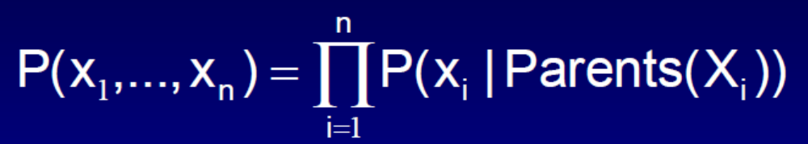
Joint Probability Distribution
A generic entry in the joint probability distribution P(x₁, … , x_{n}) is given by: x₁, x_{n}

Slide 11
Question
What is the Probability that John and Mary Calls and the alarm has gone off, but there is no Burglary and there is no Earthquake
P(J ∧ M ∧ A ∧ ¬E ∧ ¬B)
= P(J|A) * P(M|A) * P(A| ¬E ∧ ¬B) * P(¬E) * P(¬B)
= 0.9 * 0.7 * 0.001 * (1 - 0.001) * (1 – 0.002)
= 0.9 * 0.7 * 0.001 * 0.999 * 0.998
= 0.0062

Slide 12
John Calls when Alarm has gone of when there has been a Burglary.
Probability of John calling is not dependant on Burglary. It is only dependant on the Alarm going of --- Conditional Independence of Relations

Slide 13
How to Model Belief Network
Learning of Probabilities through of sequence data
We find the cause-effect relationship between the nodes.
Once we have a Belief Network, we can find the conditional probabilities of other events.

Slide 14
Incremental Network Construction
Choose the set of relevant variables that describe the domain X_{i}
2. Choose an ordering for the variables ( very important step)
3. While there are variables left:
  a) Pick a variable X and add a node for it
  b) Set Parents(X) to some minimal set of existing nodes such that the conditional independence property is satisfied
c) Define the conditional prob table for X

Slide 15
Conditional Independence Relations
If every undirected path from a node in X to a node in Y is d-separated by a given set of evidence nodes E, then X and Y are conditionally independent given E.
A set of nodes E d-separates two sets of nodes X and Y if every undirected path from a node in X to a node in Y is blocked given E.

Slide 16
Conditional Independence Relations
A path is blocked given a set of nodes E if there is a node Z on the path for which one of three conditions holds:
  1. Z is in E and Z has one arrow on the path leading in and one arrow out
  2. Z is in E and Z has both path arrows leading out
  3. Neither Z nor any descendant of Z is in E, and both path arrows lead in to Z

Slide 17
Battery
Petrol
Radio
Ignition
Starts
Whether there is petrol and whether the radio plays are independent given evidence about whether the ignition takes place.
Petrol and Radio are independent if it is known whether the battery works.
Petrol and Radio are independent given no evidence at all.

Slide 18
Battery
Petrol
Radio
Ignition
Starts
Petrol and Radio are independent given no evidence at all.
But they are dependent given evidence about whether the car starts.
If the car does not start, then the radio playing is increased evidence that we are out of petrol.

